Slide 1


0 Installation & Introduction 1 Basics 2 standard library 3 numpy and matplotlib 4 netCDF4
Python Beginners-Course
Martin Radenz (radenz@tropos.de)
Willi Schimmel (willi.schimmel@uni-leipzig.de)
Teresa Vogl (teresa.vogl@uni-leipzig.de)
LIM, 05. October 2020

Slide 2
Part 0: Installation & Introduction
Python Beginners-Course
Recommended Video: https://www.youtube.com/watch?v=Z1Yd7upQsXY
Martin Radenz (radenz@tropos.de)
Willi Schimmel (willi.schimmel@uni-leipzig.de)
Teresa Vogl (teresa.vogl@uni-leipzig.de)
LIM, 05. October 2020

Slide 3

What is Python?
An
open source
cross platform
general purpose
multi-paradigm
interpreted
programming language
free
used for (almost) everything
imperative, object-oriented, functional
not compiled as FORTRAN or C
but scientific stack also with external libraries
Notes:
first version 1991
GUI, Web, scripting

Slide 4
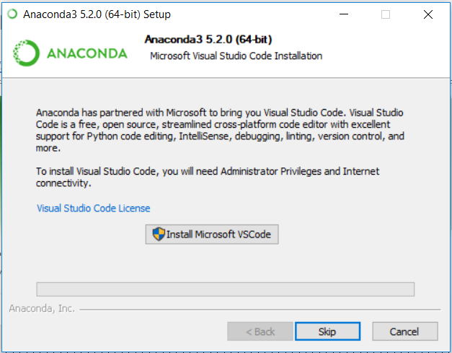
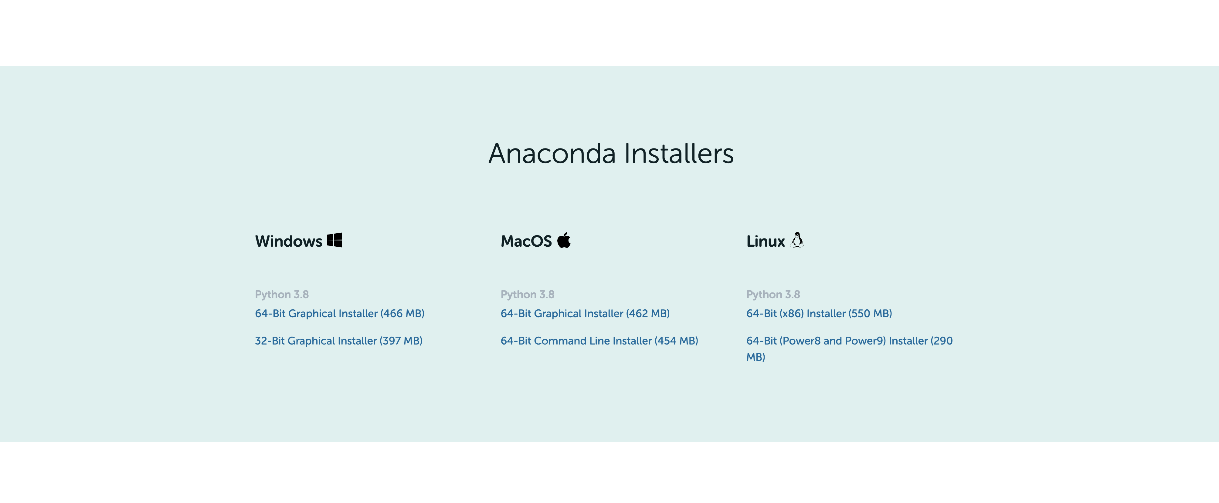
Anaconda Installation
https://www.anaconda.com/products/individual
VSCode Editor -> skip

Slide 5
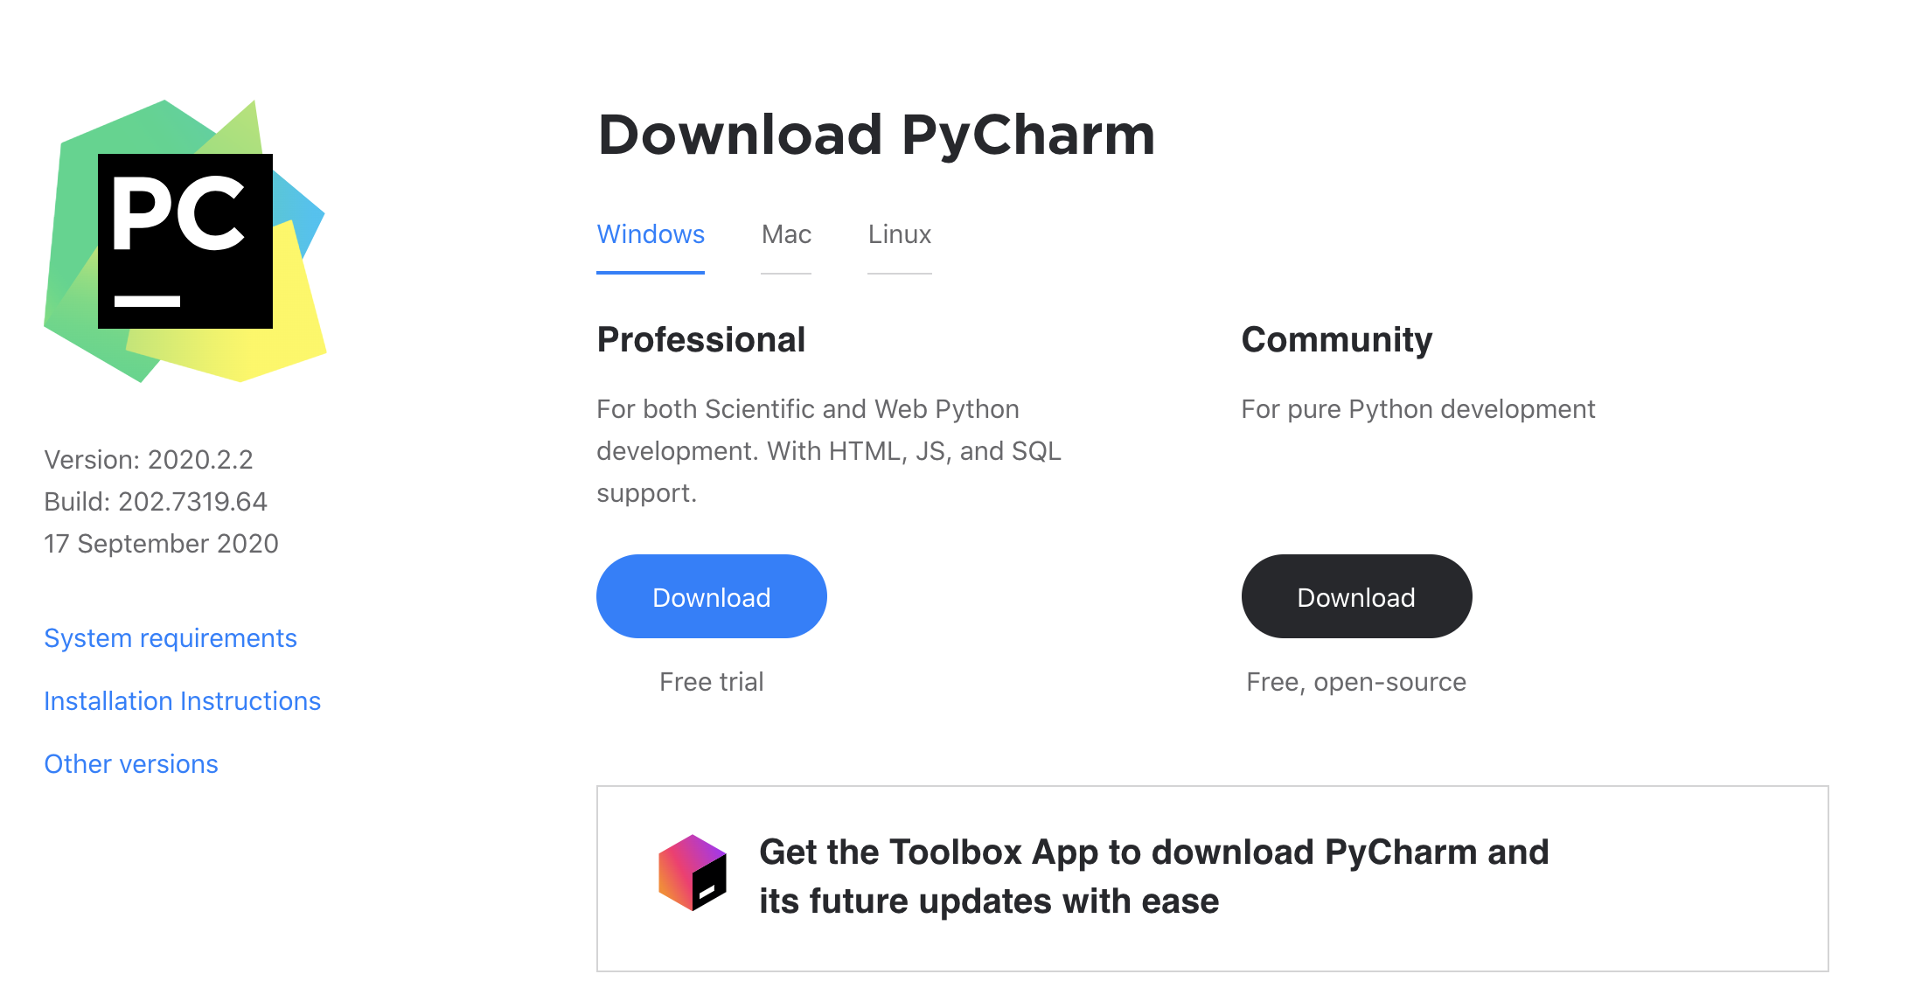
PyCharm IDE Installation
Professional Version free for
University Students
with JetBrains Account
https://account.jetbrains.com/login
https://www.jetbrains.com/pycharm/download/#section=windows

Slide 6
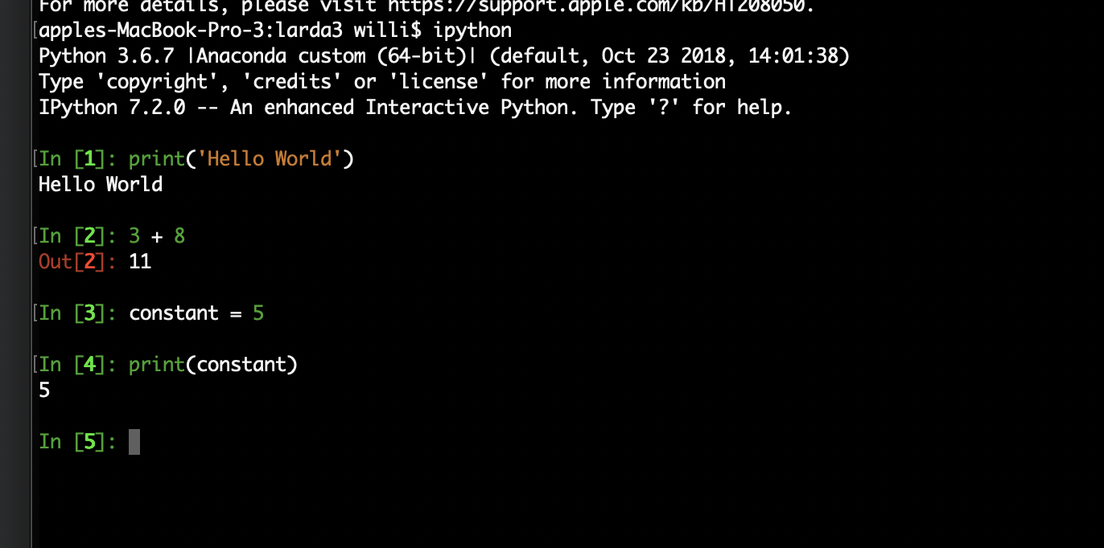
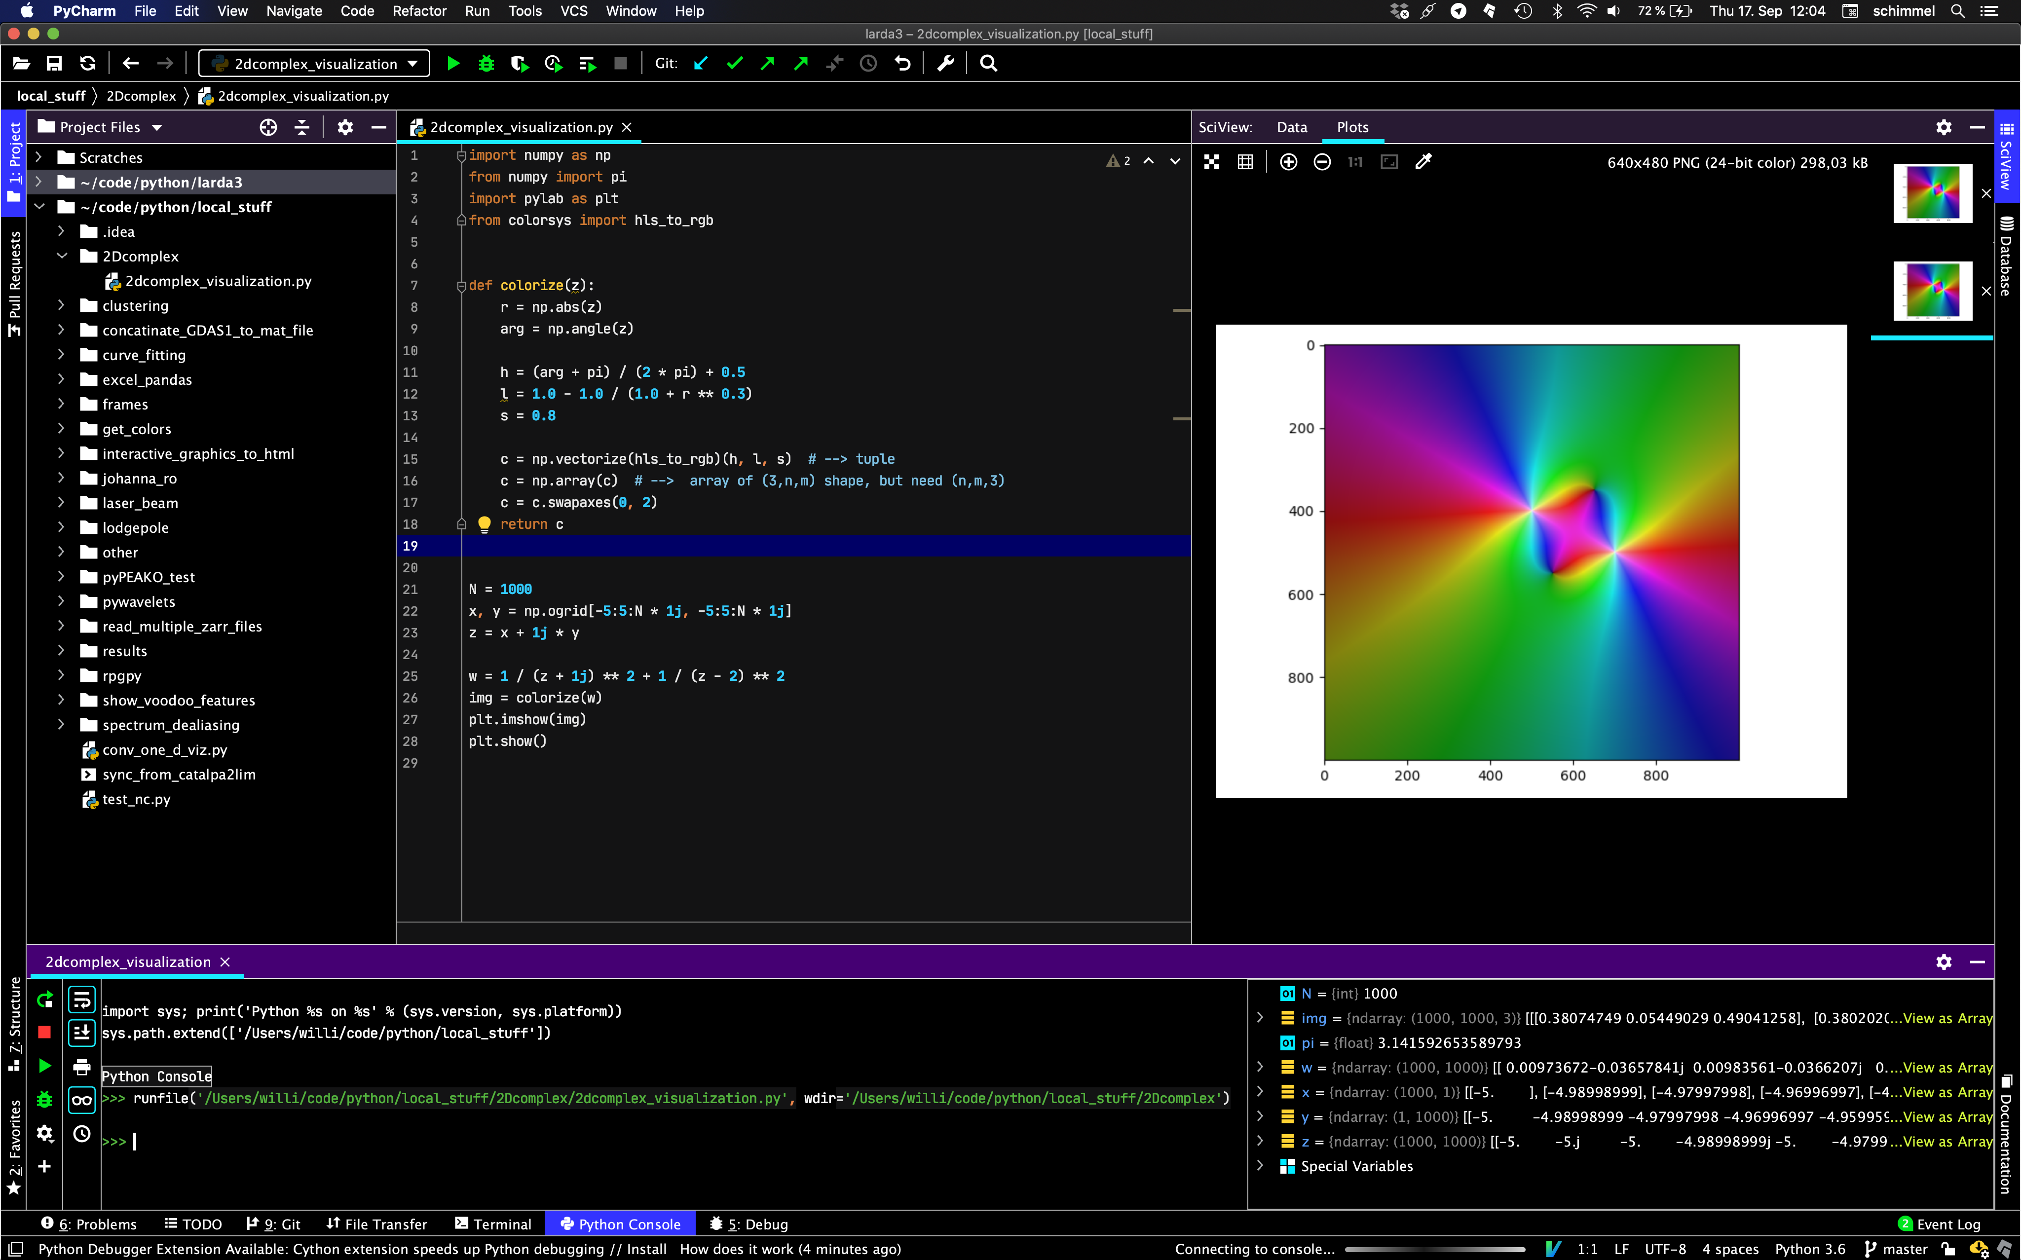
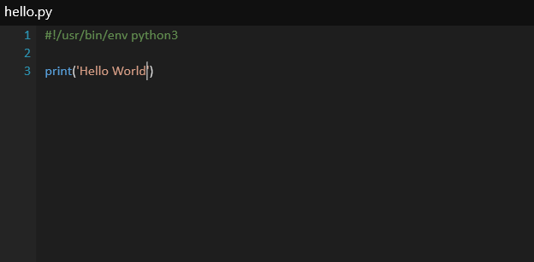
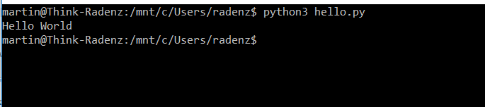
How to run the code?
ipython console
IDE (PyCharm)
script

Slide 7
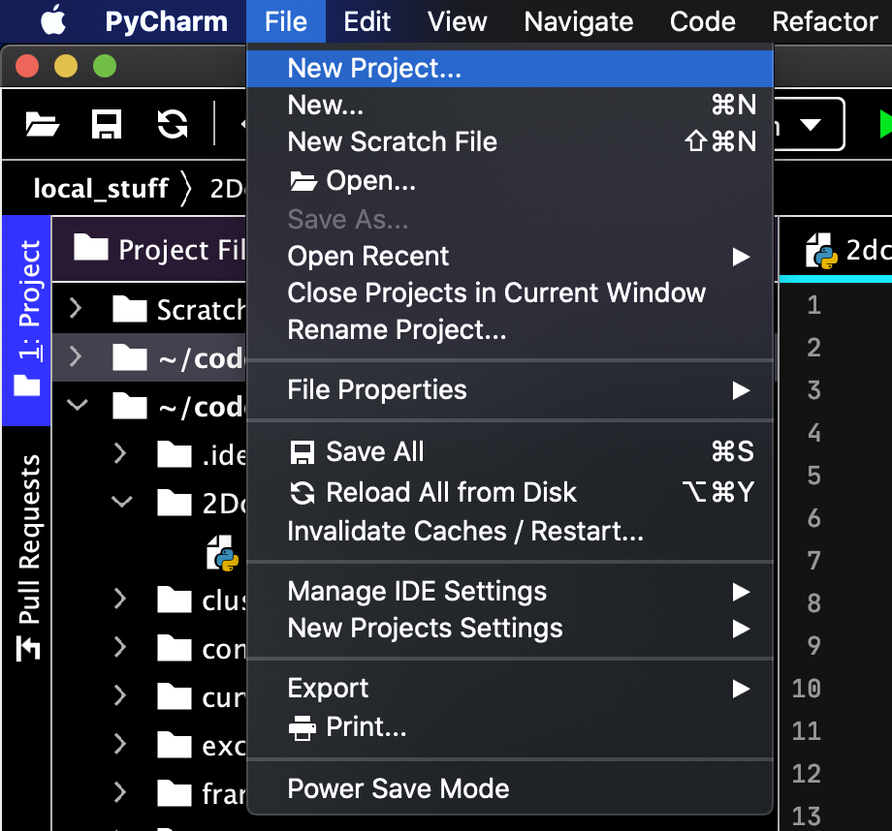
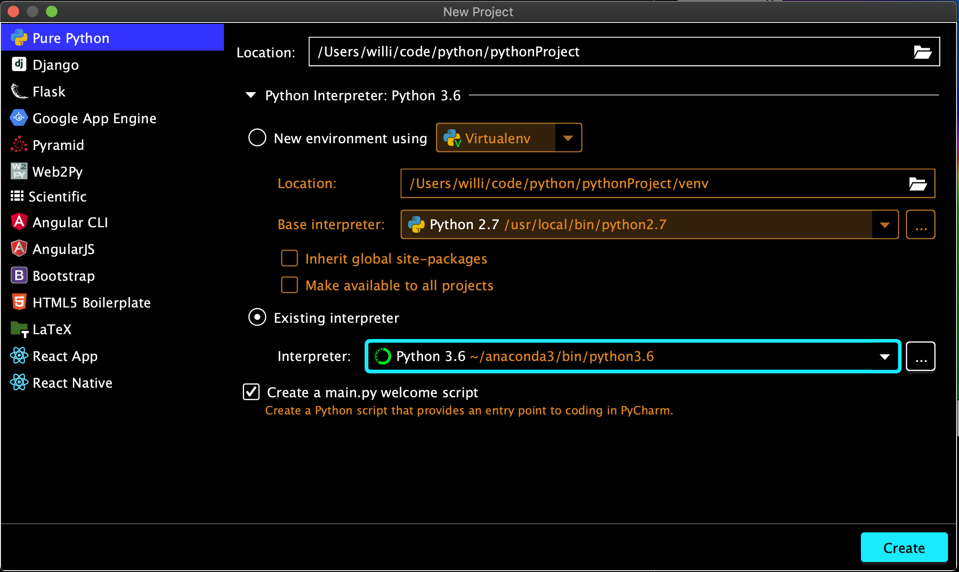
PyCharm Configuration
Adding a New Project:
Specify location of your project & configure interpreter:
optional
Add a Python Interpreter like Anaconda: PyCharm → Preferences --

Slide 8
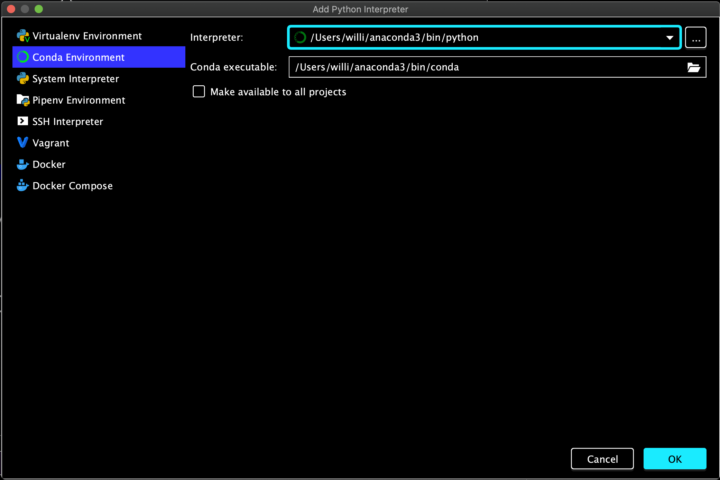
PyCharm Configuration
Specify path to Anaconda3 Python interpreter &
conda executable usually:
/Users/[name]/anaconda3/bin/python
/Users/[name]/anaconda3/bin/conda
Path specification depends on operating system
Add a Python Interpreter like Anaconda: PyCharm → Preferences --

Slide 9
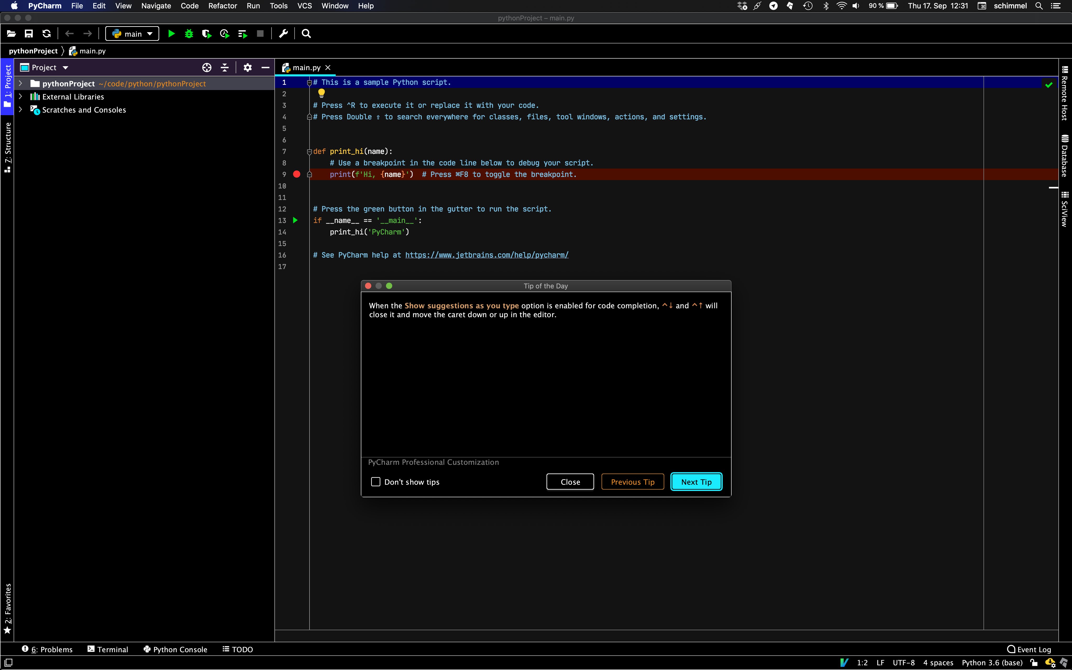
PyCharm Configuration
…done
Add a Python Interpreter like Anaconda: PyCharm → Preferences --

Slide 10
will be covered
Basics
standard library
numpy and matplotlib
netcdf
will NOT be covered
classes & advanced stuff
git version control

Slide 11
Part 1: Basics
Python Beginners-Course
Martin Radenz (radenz@tropos.de)
Willi Schimmel (willi.schimmel@uni-leipzig.de)
Teresa Vogl (teresa.vogl@uni-leipzig.de)
LIM, 05. October 2020

Slide 12
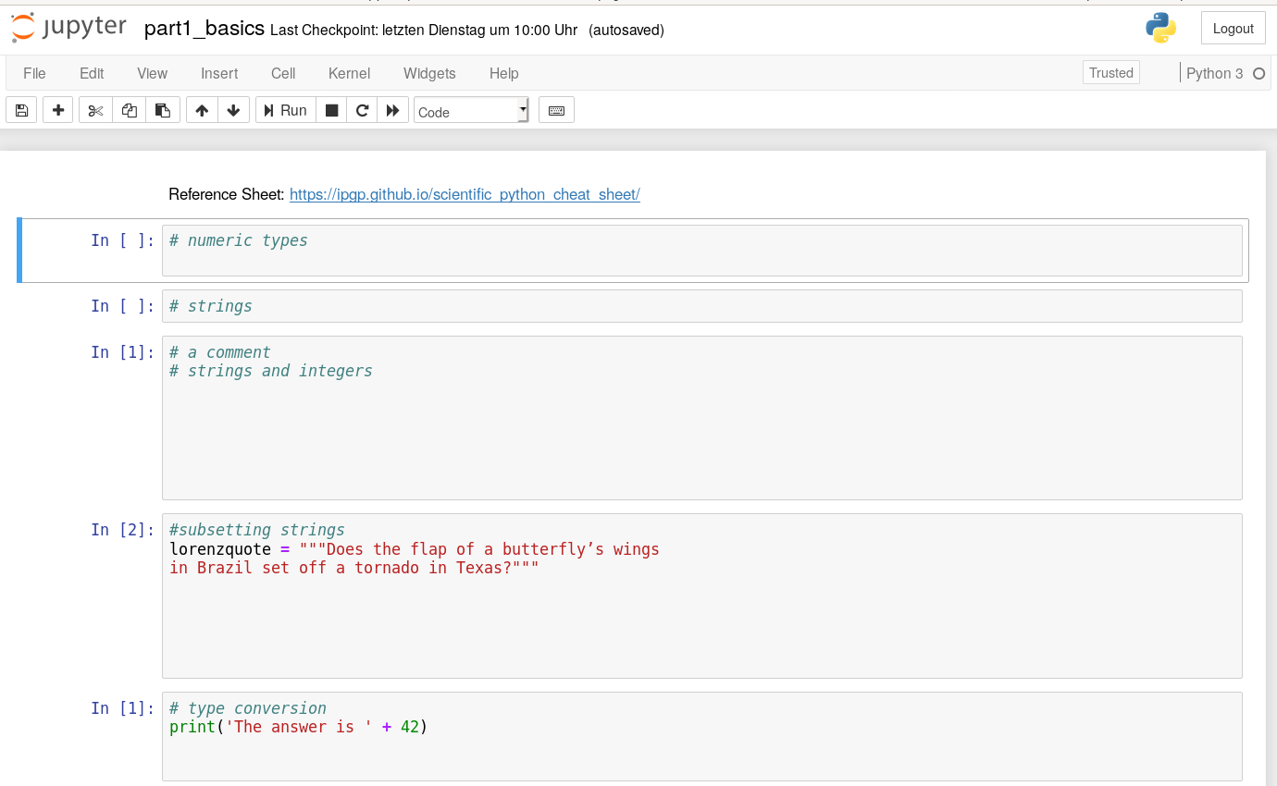
Overview
Jupyter Notebooks
“notebooks” = documents which contain both code and text elements (paragraph, equations, figures, links, etc…).
The Jupyter Notebook App is a server-client application that allows editing and running notebook documents via a web browser.
Kernels: A notebook kernel is a “computational engine” that executes the code contained in a Notebook document.
When you open a Notebook document, the associated kernel is automatically launched. When the notebook is executed (either cell-by-cell or with menu Cell -> Run All), the kernel performs the computation and produces the results.
https://jupyter-notebook-beginner-guide.readthedocs.io/en/latest/what_is_jupyter.html

Slide 13
Overview
variables
types (float, string, list, tuple, dict)
if-else
loops
functions
Reference Sheet: https://ipgp.github.io/scientific_python_cheat_sheet/
Documentation: https://docs.python.org/3.7/index.html

Slide 14
Overview
variables
types (float, string, list, tuple, dict)
if-else
loops
functions
Reference Sheet: https://ipgp.github.io/scientific_python_cheat_sheet/
Documentation: https://docs.python.org/3.7/index.html

Slide 15
Overview
Types: “numeric” types
Integers int
Floating point numbers float
Complex numbers (containing a real part and an imaginary part which each are a floating point number) complex

Slide 16
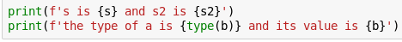
Overview
Types: strings
Textual data in Python is handeled with str objects, or strings. Strings are immutable sequences of Unicode code points. String literals are written in a variety of ways:
Single quotes: 'allows embedded "double" quotes'
Double quotes: "allows embedded 'single' quotes".
Triple quoted: '''Three single quotes''', """Three double quotes""„
„f strings“

Slide 17
Overview
Types: lists, tuples, dictionaries
Lists [a, b, c]
Tuples (a, b, c)
Dictionaries {‘a‘: a, ‘b‘: b‚ ‘c‘: c}
Notes:
Both lists and tuples are sequence data types that can store a collection of items.
Each item stored in a list or a tuple can be of any data type.
And you can also access any item by its index.

Slide 18



Overview
Indexing/ subsetting
Zero-based
Python allows you to index from the end of a list (index -1 is the last element)
0
1
2
3
4
start
(included)
stop
(not included)

Slide 19
Overview
Truth value testing
Any object can be tested for truth value
By default, an object is considered true unless its class defines a method that returns False, e.g.
None and False
Zero of any numeric type (0, 0.0, 0j, …)
Empty sequences and collections [], {}, (), ‘ ‘
Notes:
Integers = ganze Zahlen
Floats = Zahlen mit Nachkommastellen
Complex = komplexe Zahlen

Slide 20
Overview
If/ else
Conditions :
Equals a == b
Not equals a != b
Less than a < b
Less than or equal to a <= b
Greater than a > b
Greater than or equal to a >= b
These conditions can be used by „if“ statements

Slide 21
Overview
Loops

Slide 22
Overview
functions
def function_name(argument_1, argument_2, …):
do some stuff
return result
colon!
4 spaces indentation!!

Slide 23
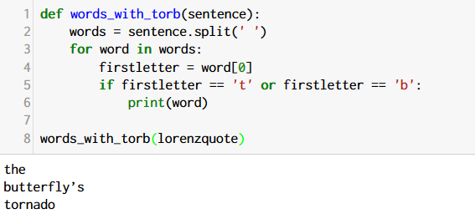
Exercise
Write a function that prints all words in a sentence starting with t or b and call it with lorenzquote.
Hints:
str.split(char)
loop through list
if decision

Slide 24
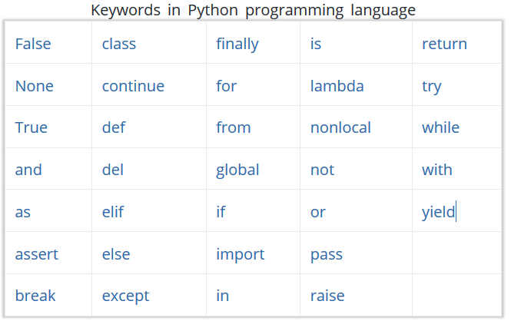

Slide 25
Part 2: standard library
Python Beginners-Course
Martin Radenz (radenz@tropos.de)
Willi Schimmel (willi.schimmel@uni-leipzig.de)
Teresa Vogl (teresa.vogl@uni-leipzig.de)
LIM, 05. October 2020

Slide 26
standard library – ‘batteries included’
python offers a lot of libraries out of the box
date and time
os interaction
regex
databases
compressing (zip, tar, …)
csv treatment
network
command line parsing
documentation
…
supplies classes for manipulating dates and times
navigating through operating system

Slide 27
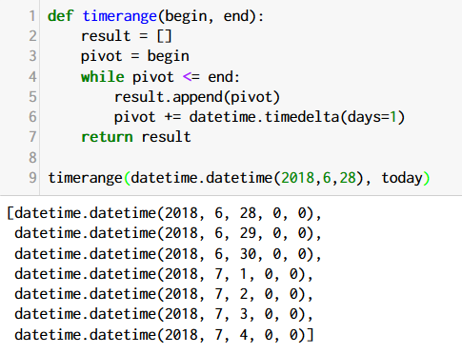
Exercise
Write a function that returns a list of dates between a given start and a given end.
Hints:
use a while loop
list.append(elem)

Slide 28
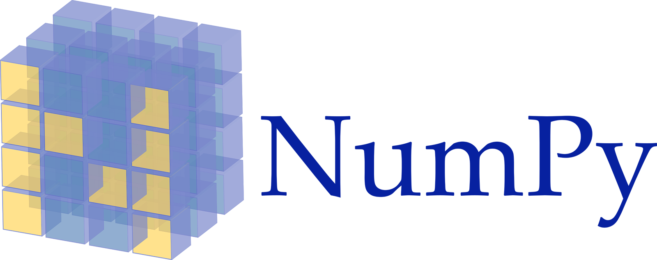

Part 3:
Python Beginners-Course
and
Martin Radenz (radenz@tropos.de)
Willi Schimmel (willi.schimmel@uni-leipzig.de)
Teresa Vogl (teresa.vogl@uni-leipzig.de)
LIM, 05. October 2020

Slide 29
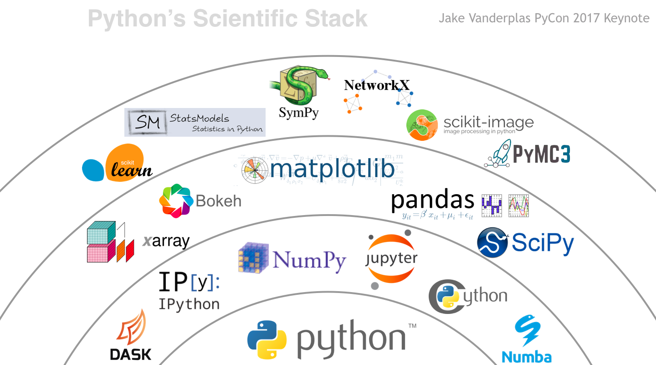
python for science

Slide 30
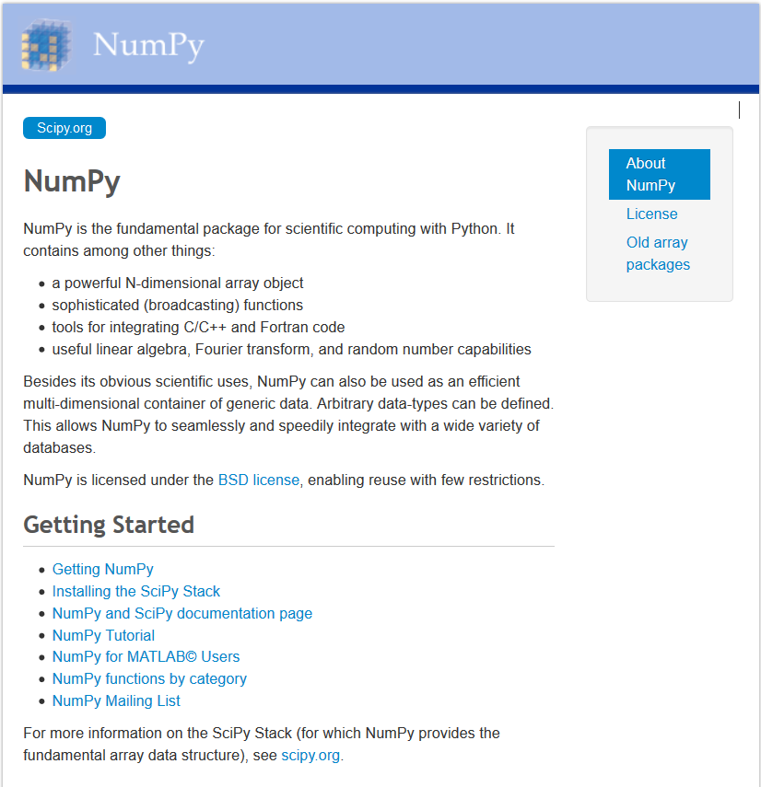
http://www.numpy.org/
python library for multi-dimensional arrays and calculations
used by many other libraries
zero based indexing

Slide 31
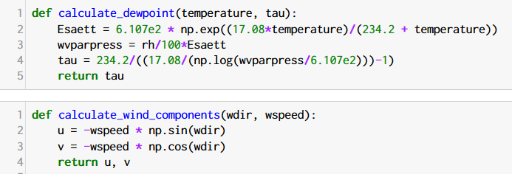
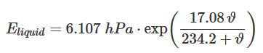
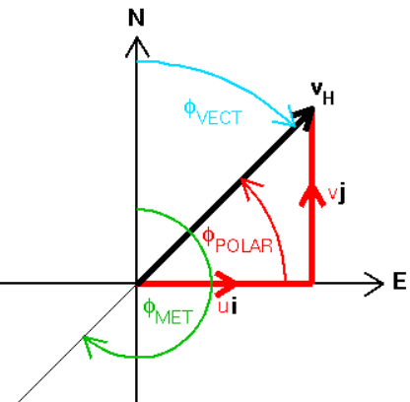
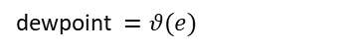
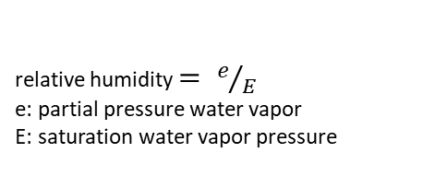
Exercise
Hints:
np.exp(array)
np.log(array)
np.sin(array)
Write a function for calculating the dew point and another one for the u,v wind components.
relative humidity $= e/E$
e: partial pressure water vapor
E: saturation water vapor pressure
dewpoint $=θ(e)$

Slide 32
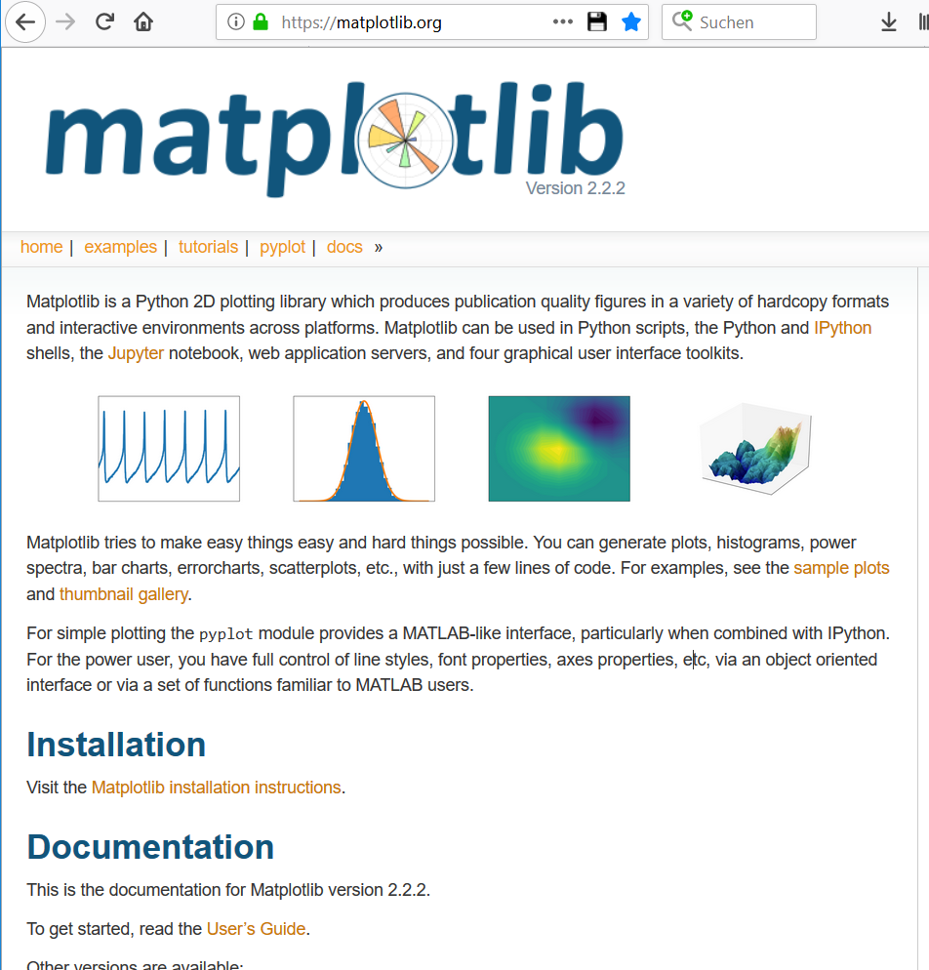
https://matplotlib.org/

Slide 33
Part 4: netCDF4
Python Beginners-Course
Martin Radenz (radenz@tropos.de)
Willi Schimmel (willi.schimmel@uni-leipzig.de)
Teresa Vogl (teresa.vogl@uni-leipzig.de)
LIM, 05. October 2020

Slide 34
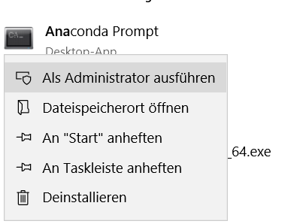
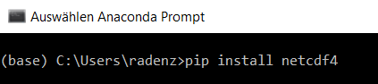
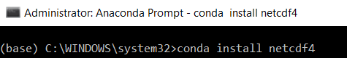
install additional libraries
OR
python package manager
anaconda package manager
right click
Notes:
in case of problems: https://stackoverflow.com/questions/28327123/installing-anaconda-python-pyhdf-and-netcdf4-for-windows-64-bit

Slide 35
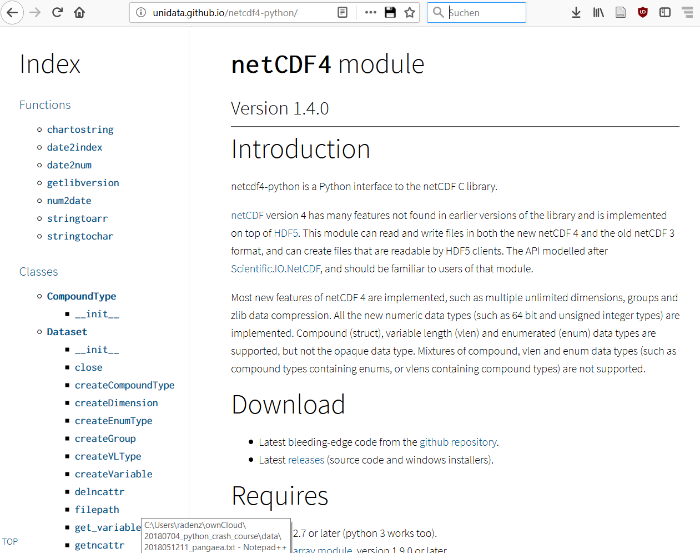
netcdf4
http://unidata.github.io/netcdf4-python/
read & write netcdf3 and netcdf4 datasets
netcdf = self-describing binary format for multi-dimensional datasets
based on hdf5 C library

Slide 36

Exercise
Convert the cloudnet time format to list of datetimes
Hints:
access netcdf attributes with f.attrname
list comprehension
datetime.timedelta()

Slide 37
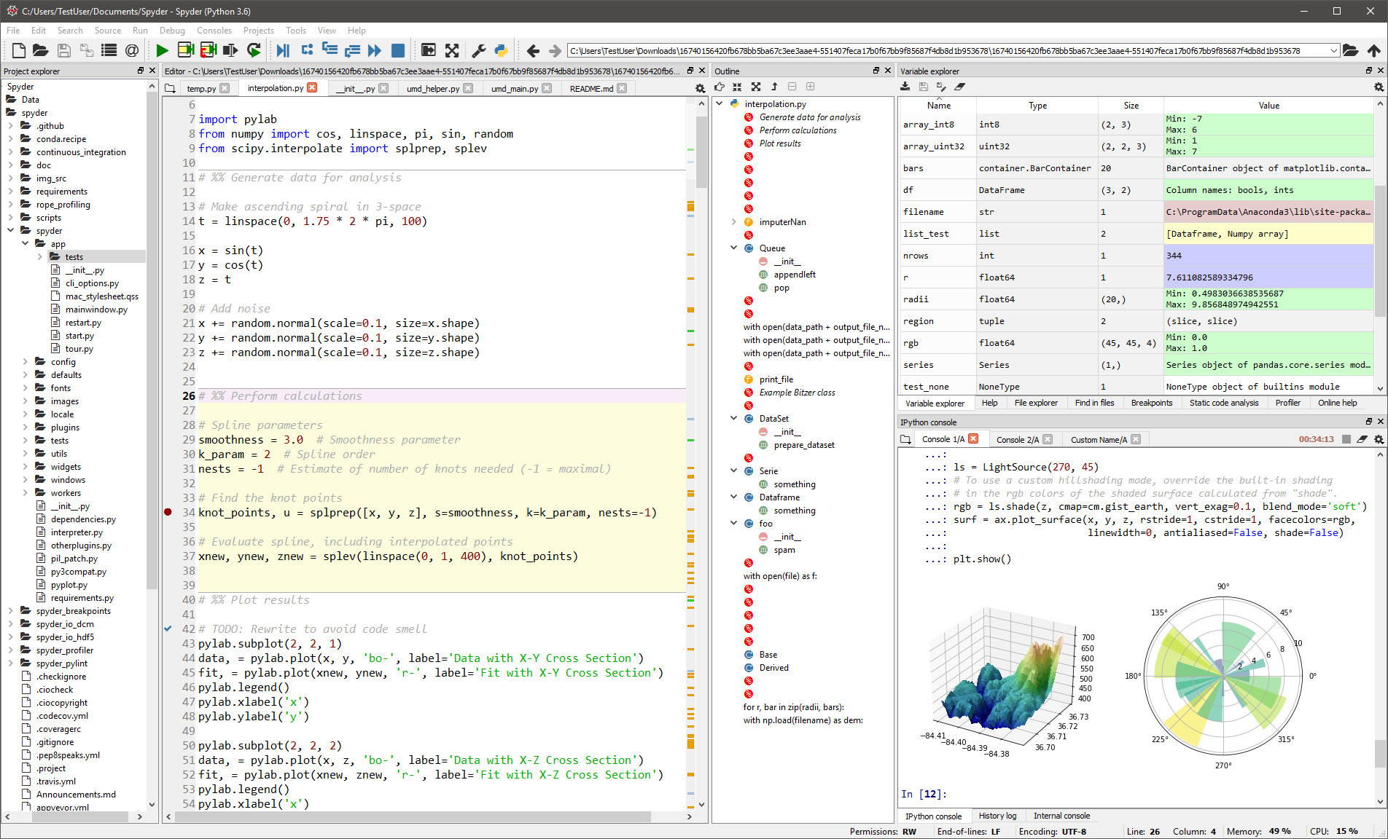
Spyder

Slide 38
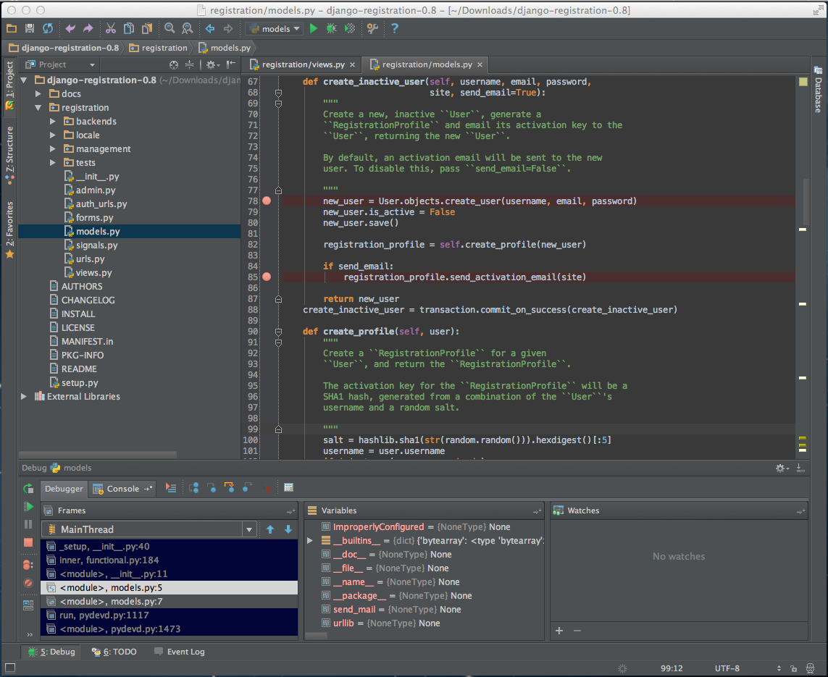
PyCharm

Slide 39
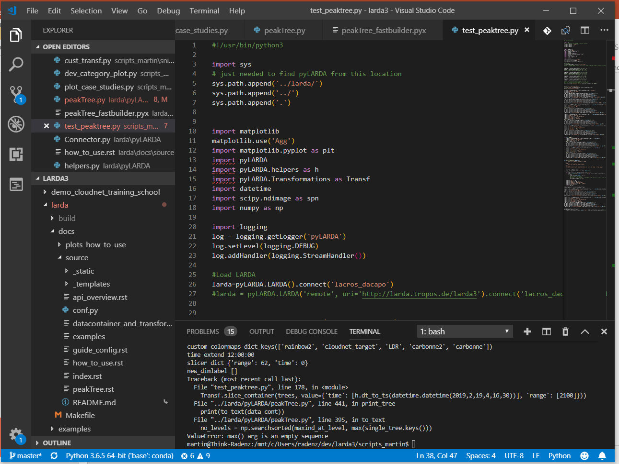
VS Code

Slide 40
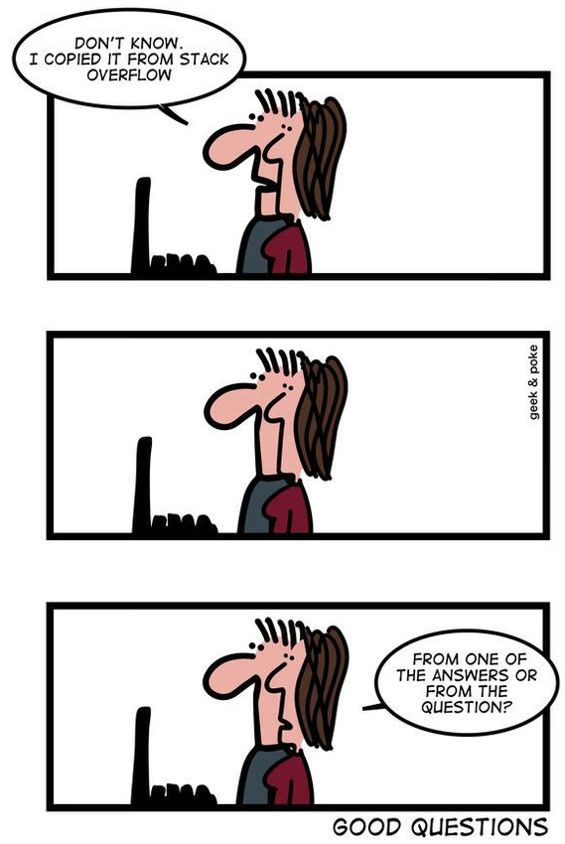
Further resources
Dive into python book (free online) http://www.diveintopython3.net/
The Hitchhiker’s Guide to Python http://docs.python-guide.org/en/latest/
https://www.scipy-lectures.org/
https://github.com/jrjohansson/scientific-python-lectures
http://swcarpentry.github.io/python-novice-gapminder/
https://github.com/juliangaal/python-cheat-sheet
Python Book (free PDF) https://link.springer.com/content/pdf/10.1007%2F978-3-030-50356-7.pdf
stackoverflow.com
Video-tutorials: https://www.youtube.com/watch?v=rfscVS0vtbw (general) https://www.youtube.com/watch?v=gtejJ3RCddE (numpy) https://www.youtube.com/watch?v=6gdNUDs6QPc (matplotlib)

